Slide 1

Debug Entities
Team members:
Irfan Essa 4008609
Hussain Junaeed 4030284
Maria Gutierrez 4031649
Waque Hasan 4026348
Abdullahi Farah 4021699

Slide 2
Why we developed mobile AND web app? Native mobile apps are built for a specific platforms, such as IOS for Apple iPhone or Android for a Samsung devices. Web apps on the other hand are accessed via the internet browser and will adapt to whichever device you are viewing them on.
Mobile App Pros | Mobile App Cons
Faster than web apps. | Expensive to maintain and update.
Safe and secure native apps must first be approved by the app store. | More expensive to build than web apps.
Can work offline. | It may prove difficult to get a native app approved by the app store.
Website App Pros | Website App Cons
Will update themselves. | Do not work offline
Quicker and easier to build than mobile apps | Slower than mobile apps, and less advanced in terms of features
Easy to maintain they have a common codebase regardless of mobile platform | Quality and security is not always guaranteed—web apps don’t need to be approved by the app store
By: Waque Hasan

Slide 3
Pros & Cons of The App
Pros Of The App | Cons Of The App
Protects User's Data. | The Potential for Ruined Lives.
Encourages Meaningful Dialogue. | Slander and Abusive Posts.
Source for Breaking News. | Anonymous Violence.
Generates Unbiased Advice. | Cyber bullying.
By: Waque Hasan

Slide 5
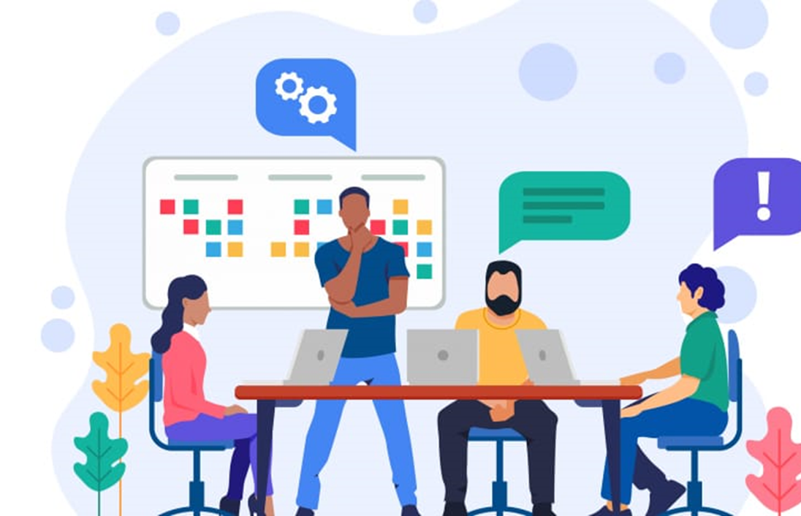
What is project it?
It is a team project where our team member made an anonymous app. We have showed complete design and development in our app. Students can share feedback with others without showing their identities. In this way, they can improve their critical thinking and motivate them to moving forward. We made two apps one for Android users and another is desktop users.
By: Junaeed

Slide 6

Why anonymous is better than exposed feedback?
Lecturer and students can provide anonymous feedback to express their thoughts without revealing their identities. This can assist them in speaking their minds and only students can provide honest response to their question. Lecture can only view frequently combined with anonymous feedback.
By: Junaeed

Slide 7
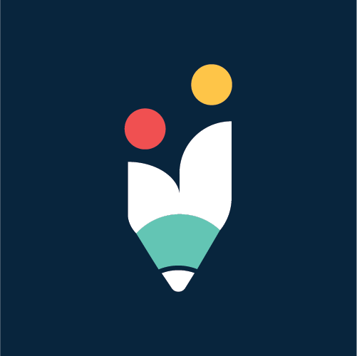



Software and development research
Creately
Visual paragrim
Adobe illustrator
Trello
- Creately is a visual collaboration tool with layout and design capabilities.
- Creately has two versions: an online cloud edition and a downloadable offline edition.
- Visual Paradigm is a Object Management Group business process modeling notation.
- In addition to modeling support, it provides code engineering and reporting capabilities, including code generation.
- Adobe Illustrator is a vector graphics editor used to edit among other things.
- It is developed and marketed by Adobe Systems and is the first official program of its kind to be launched by this company, defining in a certain way the contemporary graphic language through vector drawing.
- It is developed and marketed by Adobe Systems and is the first official program of its kind to be launched by this company, defining in a certain way the contemporary graphic language through vector drawing.

Slide 8
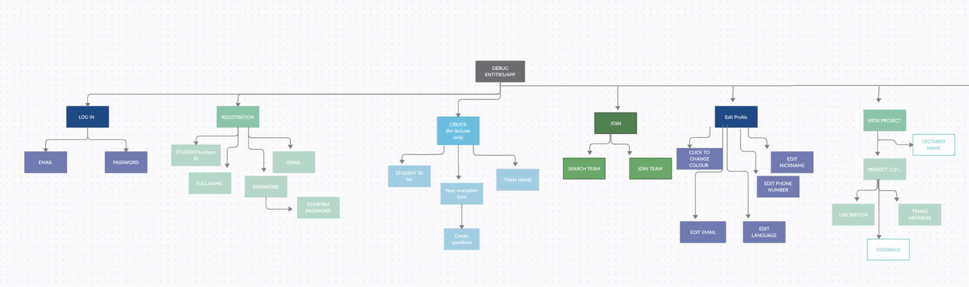
Decomposition

Slide 9

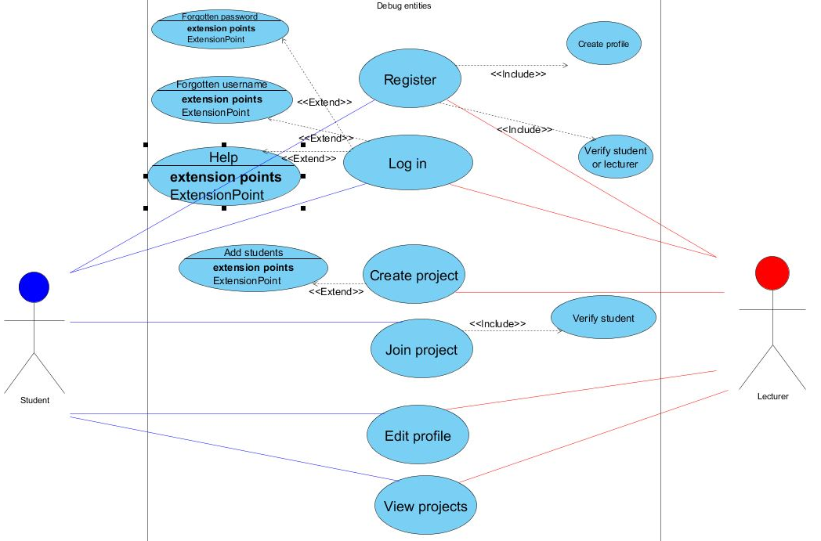
User specific use cases
Only lectures can create projects and evaluation forms
Only lecturers can view anonymous feedback
Only students can submit feedback
User | Use Case
Student | Register, log in, edit profile and join project via code.
Lecturer | Register, log in, edit profile page, create project, view feedback and download excel. Can only access own projects.

Slide 10
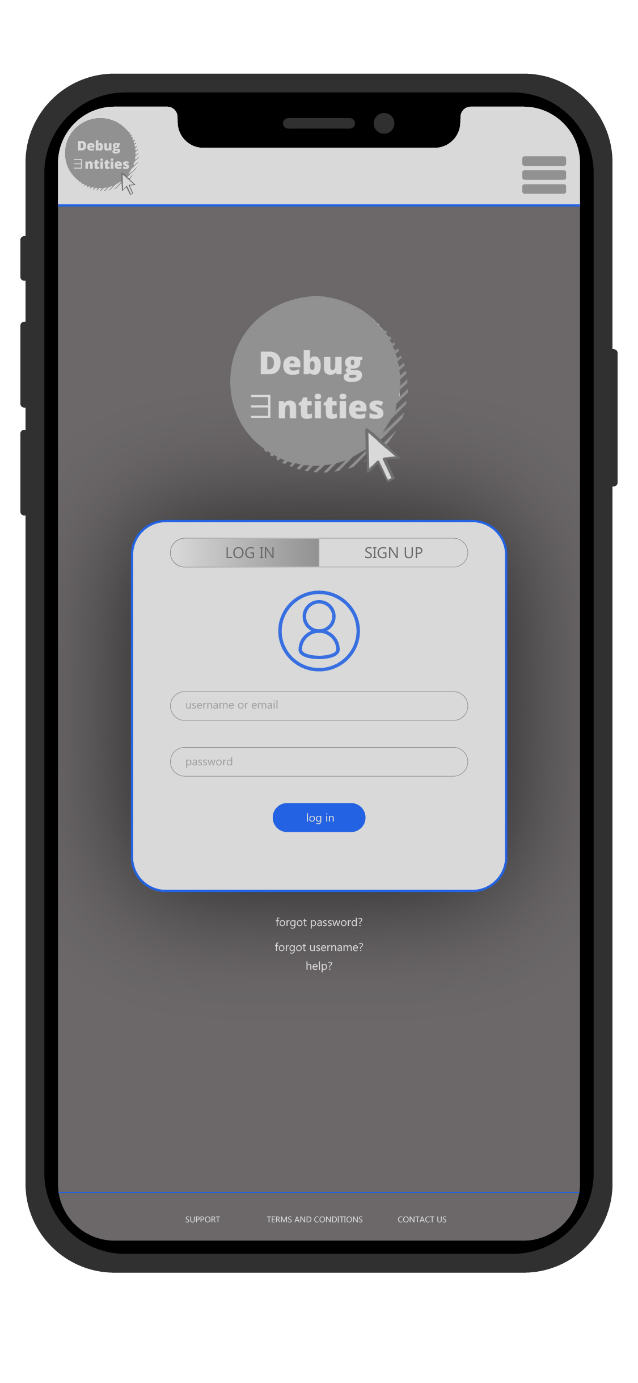
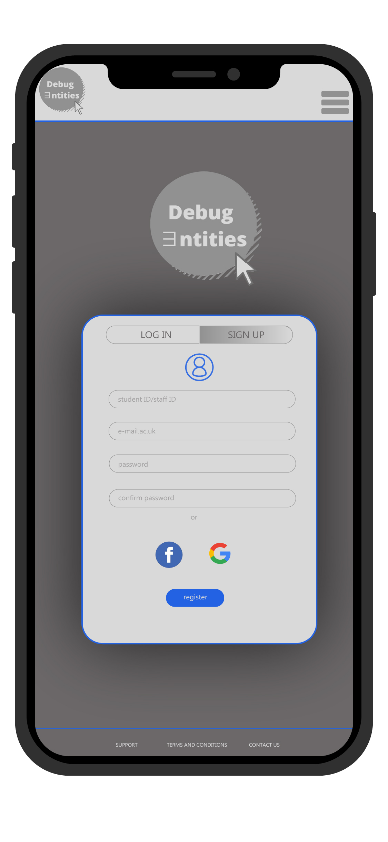
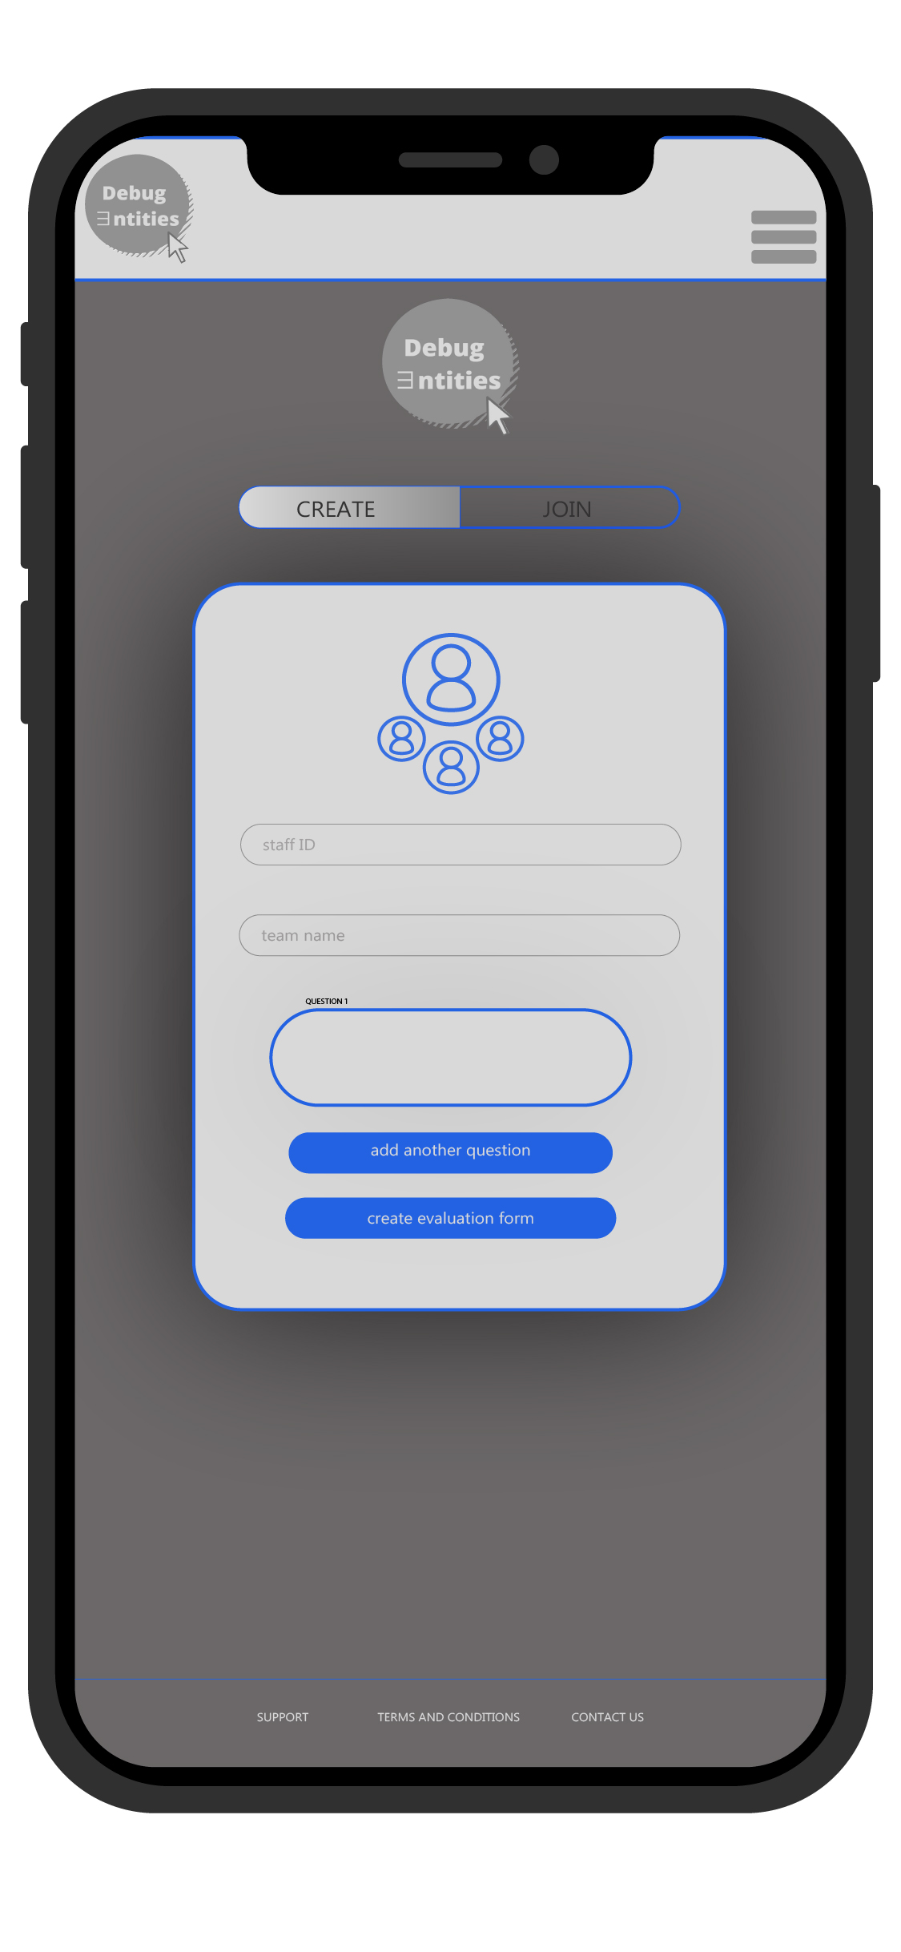
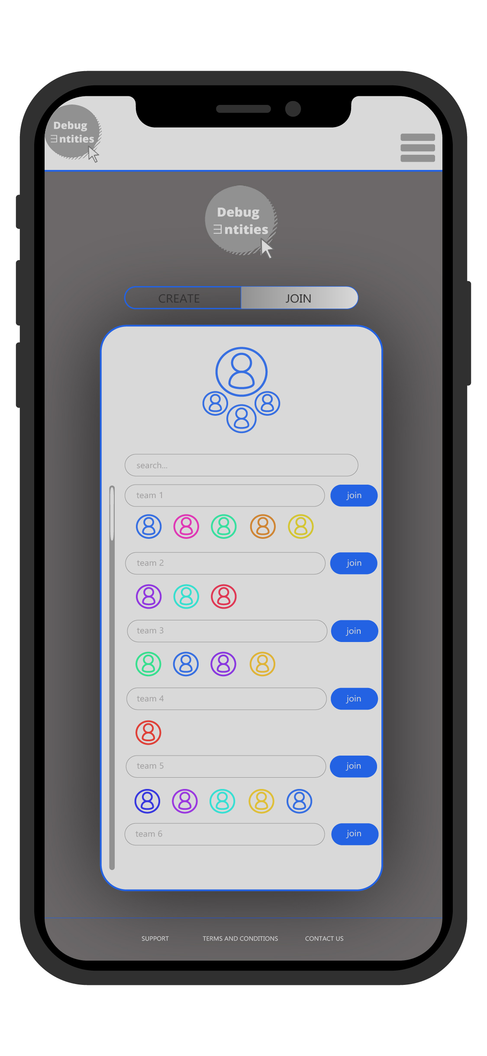
Figure 1 – Log in page
Figure 2 – Sign up form
Figure 3 – Create project
Figure 4 – Join project

Slide 11
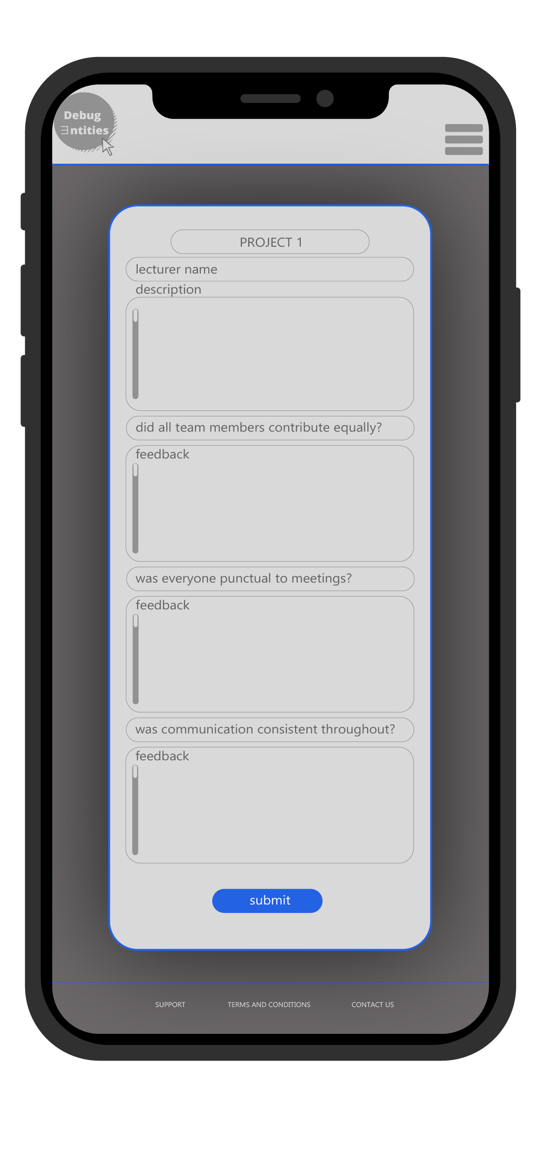
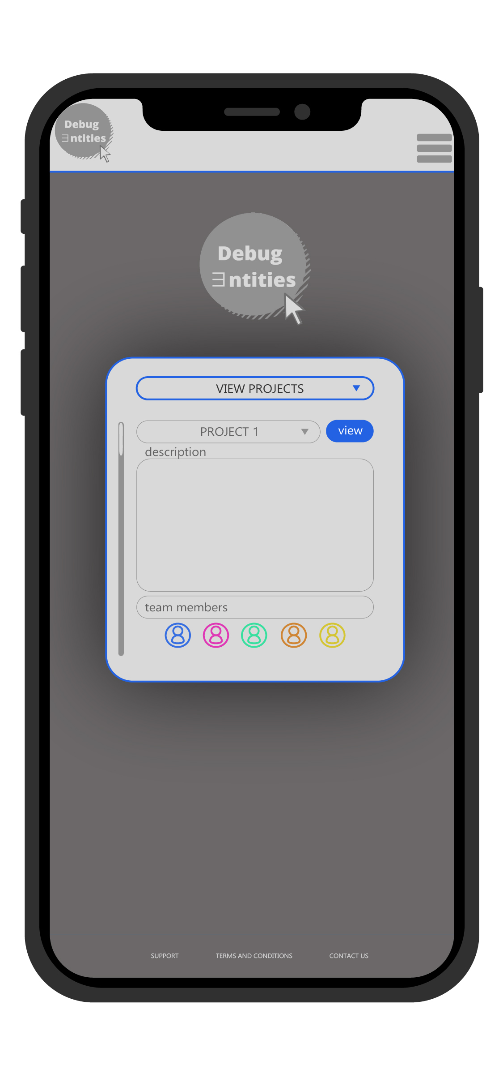
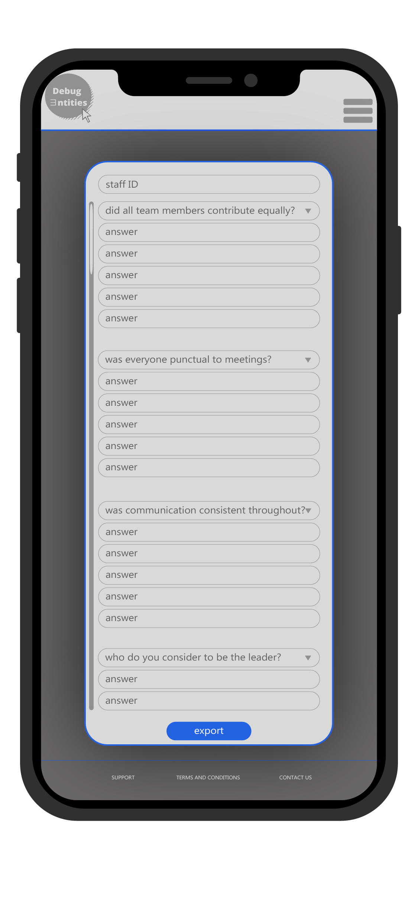
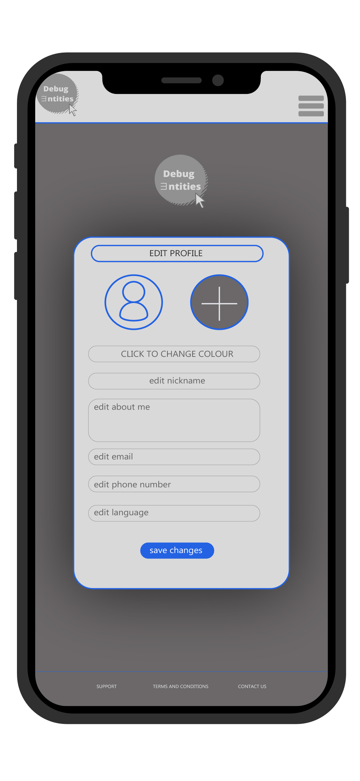
Figure 5 – Submit feedback
Figure 6 – View project​s
Figure 7 – View feedback
Figure 8– Edit profile

Slide 12
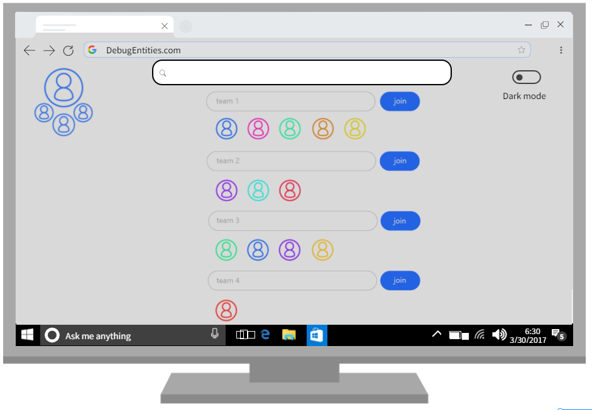
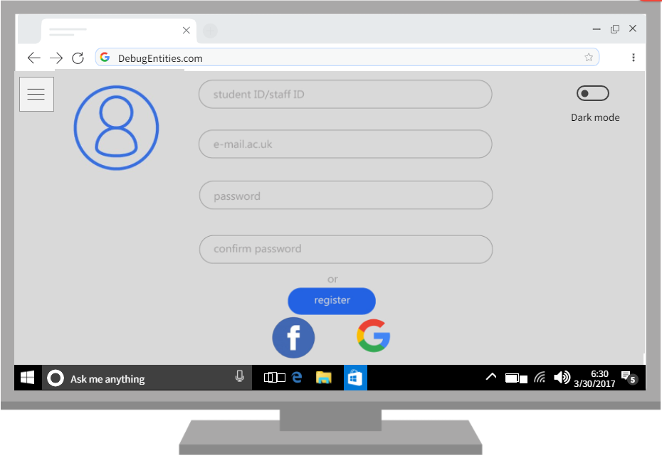
Web application examples
Figure 9 – Join team (desktop
Figure 10 – Sign up (desktop)

Slide 13

Work breakdown
Waque + Junaeed - Project overview and technical review
Irfan + Maria - Design and development
Abdullahi - Team dynamics and project management

Slide 14
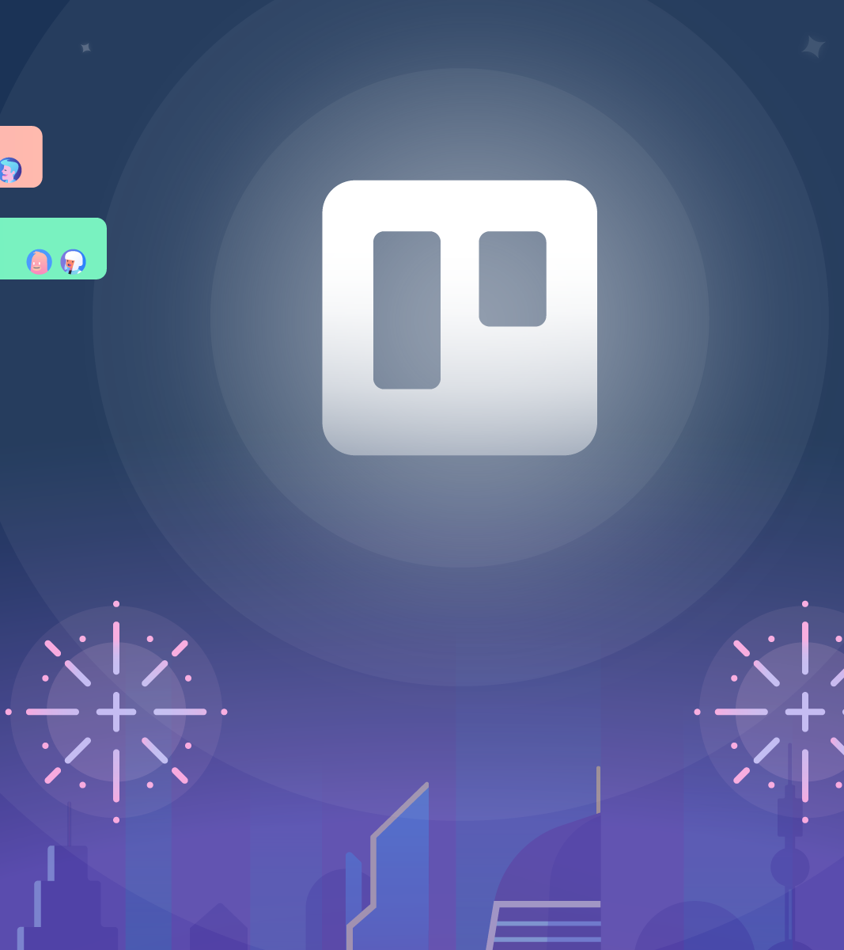
Team management
We used Trello to keep up with each other and manage our time.
We also used WhatsApp for our meetings, and we go on a group call every Friday to always insure maximum effort in our project.
We also discuss what each member does and when they do it on the weeks our team members are not available.

Slide 15
Refrences
Maria:
- (2022). Retrieved 9 March 2022, from https://creately.com/es/tour-de-productos/.
- Visual Paradigm. Capterra. (2022). Retrieved 9 March 2022, from https://www.capterra.ec/software/145716/visual-paradigm.
- Wood, B. (2022). Retrieved 9 March 2022, from https://spiegato.com/es/que-es-adobe-illustrator.
- Trello, Inspiratics. (2022). Retrieved 9 March 2022, from https://inspiratics.org/recursos-educativos/trello-una-herramienta-para-organizar-tus-proyectos-educativos/.

